Slide 1
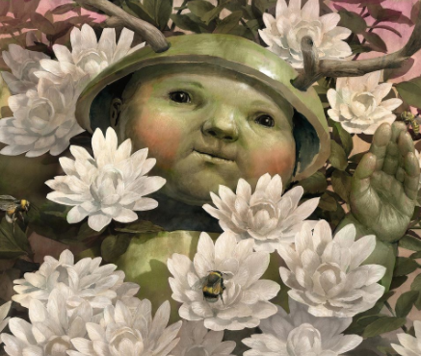
Greenling by Levi Pinfold

Slide 2
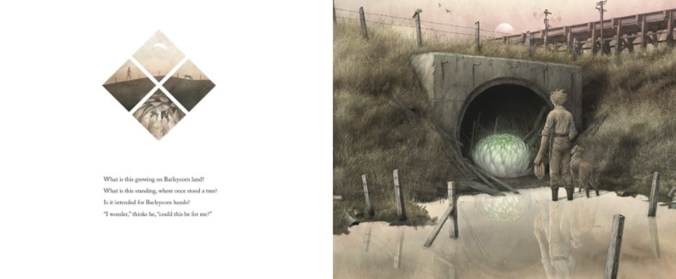
What is this growing on Barleycorn land?
What is this standing, where once stood a tree?
Is it intended for Barleycorn hands?
I wonder, thinks he, could this be for me?

Slide 3
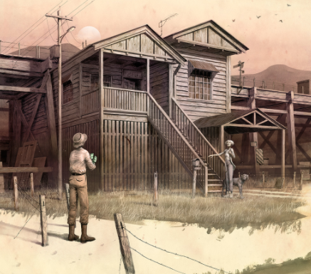
His wife wants to know where it came from.
He says, “Where the wildflowers grow.”
She says, “It belongs to the wild then,
and back to the land it should go.”

Slide 4
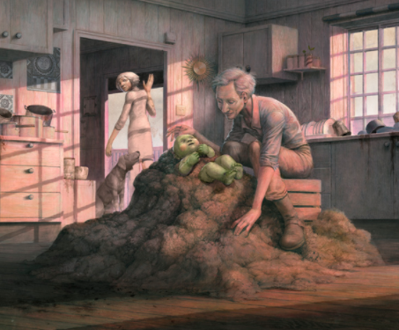
With night fast approaching Barleycorn says,
“We can’t leave him outside for the crows.
If some of this outside were inside,
He could settle in safe, if he chose.”
“I know what you’re up to,” mutters his wife,
“but keeping him here is not right.
Get rid of this goblin by morning.
He goes, or we’re in for a fight.”

Slide 5
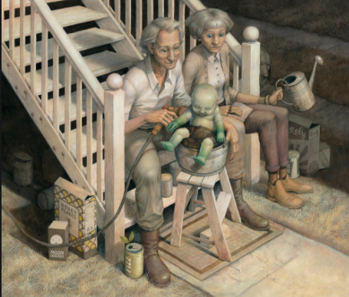

Slide 6
